Slide 1
Threads
Chapter 4
Last Updated 9/21/2017 2:03 PM

Slide 2
Processes and Threads Two Views of Operating Systems Services
Resource Manager
Managing the files, sockets, semaphores, and other resources allocated to a process.
Maintaining a virtual address space for each process’s image.
Execution Scheduling & Dispatching
Processor scheduling according to the process’s state and priority.
Assigning a processor to the execution of a process in a SMP (Symmetric Multiprocessor) system.

Slide 3
Execution Path
Recall that a process’s execution is described as its path of execution though its instructions.
A process hosts at least one execution path i.e. its main().
The execution path is blocked and resumed according to processor’s scheduling, interrupt handling, etc.
Figure 3.4 describes the Program Counter of the executed instructions for a single processor system.
The execution path is referred to as a Thread of Control, or just as a Thread.

Slide 4
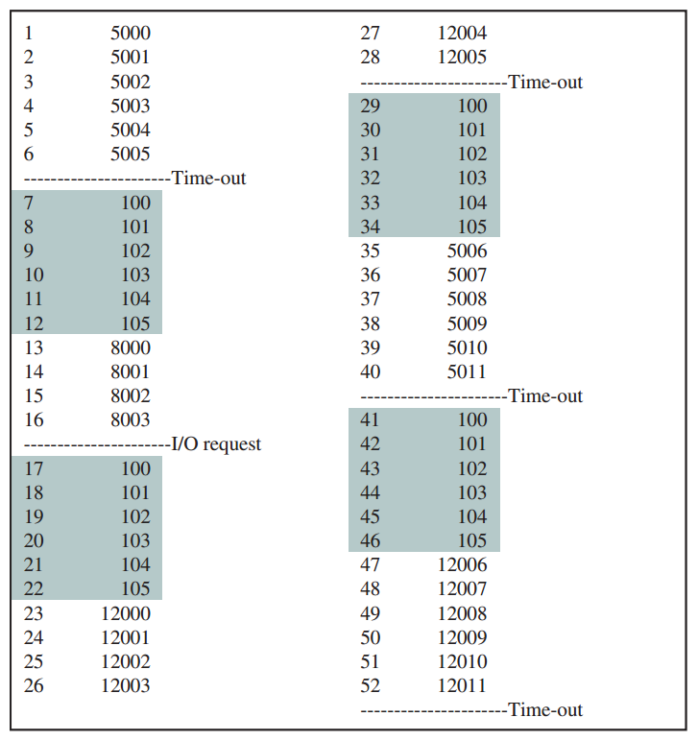
Notes:
Recall that the green instructions represent the dispatcher’s execution.

Slide 5
What are Threads?
A thread is a unit of execution that has its own stack. In an operating system context, people usually use ‘process’ to describe a thread that has its own memory image and ’thread’ to describe a path of execution that shares its image with other threads in the same process. i.e. a process has one or more threads.
One way to view threads is as multiple processes that share a single image.
Instructions, allocated (heap) memory, files, sockets, etc. are shared between threads created in the same process.
Each thread has its own processor state and control stack.
Each thread is individually scheduled for execution.

Slide 6
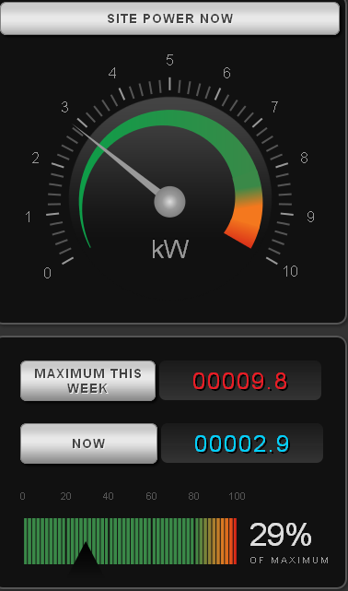
Example: Message Handling GUI
Imagine a program that receives network messages and presents data on a user interface.
Message arrive from external applications across a socket connection.
The interface is being continuously updated by the user and the arrival of new data.
Sockets provide blocking I/O.
A thread’s execution will block if it reads an empty socket.
With two threads, we can both update the GUI and wait for new message to arrive.
Very difficult to implement with a single thread.

Slide 7
Every Thread Maintains…
An execution state (Running, Ready, Blocked, etc.).
A thread context that is saved and restored as the thread is scheduled for execution called the Thread Control Block
The thread’s identity (Thread ID, Owning Process ID)
A Per-Thread Processor State (PC, SP, Registers, etc.).
An execution (control) stack maintaining function calls, local variables, etc.
Shared access to the memory and resources allocated to the thread’s process.
Notes:
Note that the processor state is no longer associated with the Process but with the Process’s Threads.

Slide 8
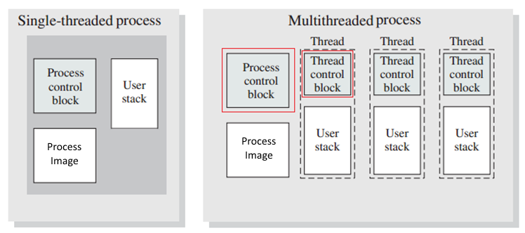
Single vs Multithreaded Process Model
Notes:
The PCB contains process resources (files, sockets, etc.) that are shared by all threads.
The TCB contains resources specific to a thread (control stack, processor state).

Slide 9
Multithreading
‘Multithreading’ is support in the OS for multiple threads of execution (instruction traces) within a single process.
A process starts its execution in a single thread.
The program’s main() in C / C++ / Java / etc.
New threads are explicitly created using system services as needed by the program e.g. Posix Threads API in C and Unix.
pthread_create(thread, attr, start_function, arg)
pthread_exit (exit_status) : Allows a thread to exit.
pthread_cancel (thread) : Allows threads to be destroyed.

Slide 10
Threading OS Models
Operating Systems can be categorized according to the types Processes and Threads they support.
One Process / One Thread: Simple embedded or very primitive Operating Systems e.g. MSDOS.
Multiple Processes / Single Thread per Process: Early Mainframe Operating Systems.
One Process / Multiple Threads: Virtual Machines (e.g. JavaVM).
Multiple Processes / Multiple Thread per Process: Modern OS.

Slide 11

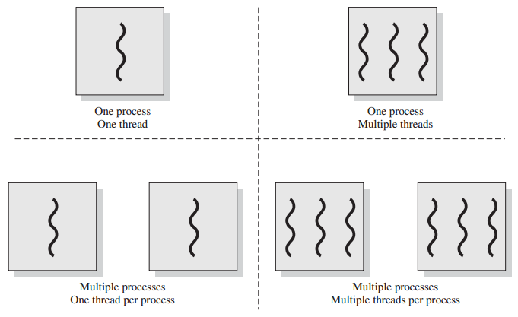
Support for Processes and Threads in various OS Models.
MS DOS
Java VM
Embedded OS
Early Operating Systems
Modern Operating Systems
Notes:
Embedded OS: The software running high-end consumer electronics e.g. TV, DVR. i.e. one application with many possible threads.

Slide 12
Advantages of Threads over Processes
Threads can be created and destroyed more efficiently than processes.
Threads can be created an order of magnitude more quickly that processes.
N threads require fewer resources than the same number of processes.
Memory and other resources are shared between threads in the same process.
Threads enhance communication between concurrently executing instruction traces.
Threads share access to memory and other resources allocated to their process while processes are isolated from each other.

Slide 13
Threads Characteristics
Threads are implemented as operating system resources.
The OS kernel maintains both process and thread contexts.
Multiple threads per process can be running concurrently on a multi-processor.
Multiple threads can be executing at the same time allowing for an increase in application performance.
Kernel threads are individually blocked by I/O requests i.e. some threads can be block, others not, in the same process.

Slide 14
POSIX Thread Creation in C / Linux
Linux thread library is Pthreads. (POSIX Threads).
The function threadMain() is executed in the new thread.
The function pthread_create() is used to create a new thread.
void* threadMain(void *arg){… Thread instructions goes here …}
int main(void) {
static pthread_t tid;
static int arg = 1;
pthread_create(&tid, NULL, &threadMain, &arg);
}
pthread_create() arguments:
tid: The thread-id of the created thread.
A reference to the thread’s entry function.
A reference to the function’s arguments.

Slide 15
POSIX Threads Library
The POSIX Threads Library contains a number of functions used to create, control, and kill threads from within a process.
These are a few of the functions provided by pthreads:
The thread exits when the called function returns or by calling the syscall pthread_exit().
A thread can block its execution while waiting for a second thread to exit using the function pthread_join(pthread_t*).
The library contains a number of thread synchronization primitives (e.g. semaphors) covered in the next section.
Notes:
The ‘p’ is for Posix.

Slide 16
Why Threads?
Threads simplify programming strategies for utilizing SMP to increase the performance of an individual process.
A thread executing on its own processor can execute in parallel with other threads.
Notes:
Symmetric Multi Processing or Processor

Slide 17
Multithreaded Control Strategies
Threads provide a programming strategy for partitioning and encapsulating functionality in software design.
Threads make possible several design strategies (patterns) that can be employed to solve tough design problems.
Worker Threads: If the problem involves processing units of work, multiple SMP threads can be employed to process several units in parallel.
Scheduled Tasks: A task, possibly many tasks, may periodically execute some action that is required to maintain the system.
Event Handling : Events delivered to the system require a specific response (event handler instruction). Each event handler can be allocated a thread whose execution is blocked waiting for the event to arrive (Blocking I/O).
Notes:
Note To Students: I consider knowing these three control strategies to be important.

Slide 18
Worker Threads Control Strategy
A network application which receives requests for services from multiple clients.
A server process that ‘services’ client requests returning some information e.g. HTTP server returning web pages, images, etc.
The server process maintains a number of worker threads each of which services a single client request.
A pool (collection) of N threads is maintained by the application.
With SMP, multiple requests can be process concurrently seeing an approximate N fold increase in performance.
Depending on the amount of conflict for shared resources such as for a database or shared data structures.
Notes:
SMP: Symmetric Multiprocessors i.e. a processor with multiple cores. Almost all modern processors have multiple cores.

Slide 19
Processing Multiple Client Requests using Worker Threads

Slide 20
Task Scheduling Control Strategy
A thread is dedicated to periodically executing some task.
Execute a function every N seconds.
while (true) {
doTask();
sleep(N seconds);
}
This loop is executed by a thread which continues sleep / execute cycle until terminated.
This is an excellent strategy for implementing a service that must be periodically executed.

Slide 21
Event Handling Control Strategy
A thread is dedicated to responding to (handling) asynchronous events.
For example, waiting for a message to arrive on a network socket.
while (true) {
message = socket.read(); // A blocking read operation
process(message);
}
The socket’s read operation will block the thread until a message arrives when the thread unblocks and processes the message.
This strategy can be applied to any situation where a thread’s execution can be blocked until an event triggers its activation.
Notes:
Example Event Handling: A thread can be created to listen for messages to arrive on a socket from a remote client. The thread’s execution will block when no socket data is available, but other threads can keep the application active.

Slide 22
Sharing Resources between Threads
Sharing resources between processes is complicated.
By design, memory, sockets, and other resources allocated to a process is inaccessible by other processes.
Sharing resources between threads is simple.
Each thread has direct access to the resources allocated to its process image e.g. memory, files, sockets, semaphores, etc.
This simplicity make it relatively easy to build applications that benefit from the performance gains from SMP systems.
Especially when utilizing a programming language that supports Threads and synchronization e.g. Java, C#, Python, & others.
Notes:
SMP: Symmetric Multiprocessing i.e. multi core microprocessors.

Slide 23
Resources Shared Between Threads
Process Memory: Memory owned by a process is accessible to all threads owned by the process.
A change to memory made by a thread will be seen by all threads.
A vast improvement in performance over older Inter-Process Communication (IPC) mechanisms e.g. Pipes.
Semaphores: Used to coordinate the activities of multiple threads (and processes) when accessing shared resources.
Semaphores are shared and manipulated by multiple threads.
Network Sockets and File Descriptors:
A socket or file descriptor owned by a process can be read or written to by any thread in the owning process.

Slide 24
Thread Processing States
Threads are scheduled and dispatched by the OS in much the same way as Processes.
Threads maintain these states:
Spawned: Created by a parent thread with a call to the OS.
The Thread Control Block is created and assigned an instruction address to begin the thread’s execution.
Ready: Ready to execute but waiting to be dispatched to a processor
Running: Assigned to and executing on a processor.
Blocked: Waiting for I/O or other events to occur.
Exited: Releasing any thread’s resources (e.g. TCB & stack), but none of the process’s resources (e.g. memory, files, sockets, etc.).
Notes:
TCB: Thread Control Block
Note that like Processes, a thread will be blocked while waiting on a message, waiting for a blocking system call to complete, etc. Other threads in the blocked process remain runnable while the blocked threads waits.
When a Process is suspended, all of its threads are suspended. Threads can not be individually suspended.

Slide 25
Multicore and Multithreading
Multicore and multithreading seem like a great idea but…
Can we take a program that runs in 10 units on a uniprocessor and expect it see it run in …
5 units on a 2 processor system?
2 units on a 5 processor system?
Can we get a N-way speedup on a N processor system?
No! This is because most applications have some amount of code (algorithms) that must be run serially in a single thread.
This section discusses these issues and gives advice on the performance gains to expect from parallel execution.

Slide 26
Parallel Merge Sort
Merge Sort uses divide and conquer to sort an N element list in logarithmic time.
Parallelizing merge sort is intuitive in that the divided sets can be sorted in parallel.
Each of the sets of 500 element can be sorted in parallel.
However merging every 2 sets into a single set is serial.
Most problems (algorithms, business rules, etc.) contain some processing that can be parallelized and some processing that cannot.
Notes:
The 4 third-level sorts and 2 second-level merges can be executed in parallel.

Slide 27

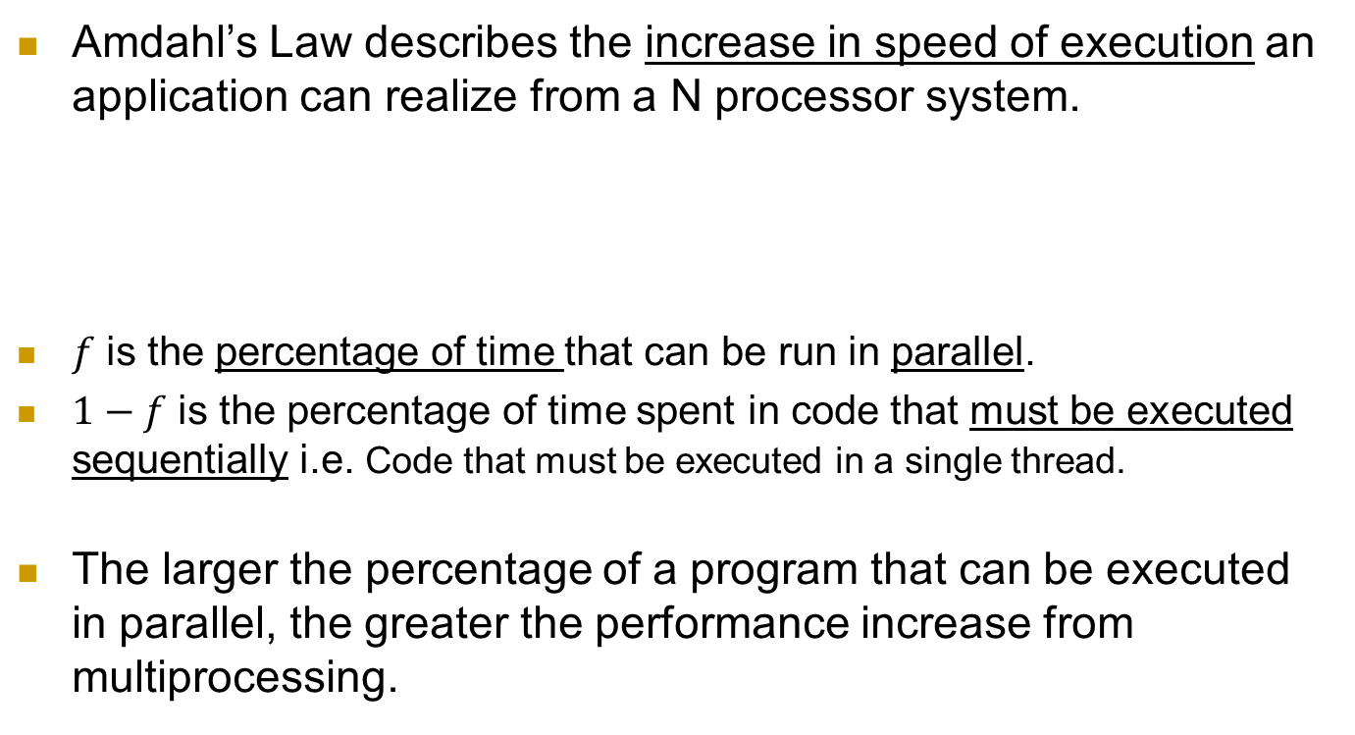
Amdahl’s Law Example of “Law of Diminishing Returns”
Amdahl’s Law describes the increase in speed of execution an application can realize from a N processor system.
$f$ is the percentage of time that can be run in parallel.
$1−f$ is the percentage of time spent in code that must be executed sequentially i.e. Code that must be executed in a single thread.
The larger the percentage of a program that can be executed in parallel, the greater the performance increase from multiprocessing.
Notes:
If f = 1 and N = 4, result is 4 times speedup.
If f = 0 and N = 4, the result is 1 or no speedup.
If f = .75 and N = 4, the result is 2.2 times speedup.
If f = .25 and N = 4, the result is 1.2 times speedup.

Slide 28
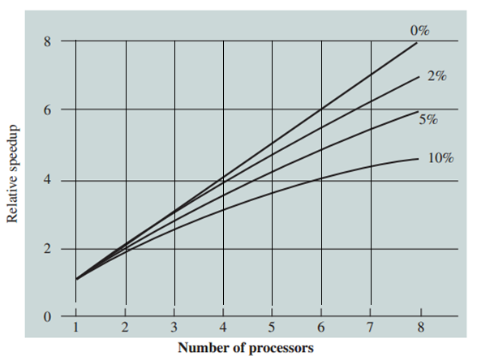
Effects of Amdahl’s Law are Surprising
With only 10% serial (non-parallel) execution, we see a substantial drop off in speedup with N > 3 processors.
Speedup with (1 - f) (Sequential Processing) 0%, 2%, 5%, and 10%

Slide 29
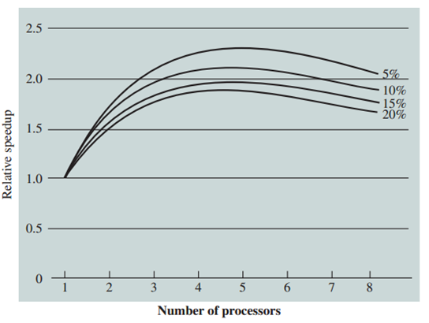
Speedup is further reduced when considering the overhead of supporting multiprocessing in the OS i.e. memory conflicts, resource locking, synchronization, etc.
OS multiprocessing overhead greatly reduces the speedup obtained from N > 5 processors.
Notes:
This graph includes the operating system processing overhead of supporting multiple processors.

Slide 30
There are several techniques for increasing system’s performance
Coarse Threading: Where services are partitioned into N Processes that can be executed on multiple processors.
Algorithms that execute on batches of data (batch processing).
N-Tier and Dataflow (Pipes & Filters) architectures.
Fine-grained Threading: Where an algorithm can be partitioned into N Threads that execute concurrently.
Algorithms that execute on data in shared memory.

Slide 31
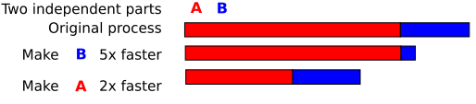
Understand the system before attempting to optimize performance
Systems can be made up several components (subsystems) that can be individually profiled and optimized.
In this example, the optimizing either A or B requires equal development effort, but provides substantially different benefits.

